Slide 1
Milk Testing for Dummies
The Nuts and Bolts of Getting Started on Milk Test
Trina Voss Getfoola Farms trina@getfoola.com
©2018 Getfoola Farms
This document may be distributed freely, so long as it is not modified and the copyright is not altered or removed.

Slide 2
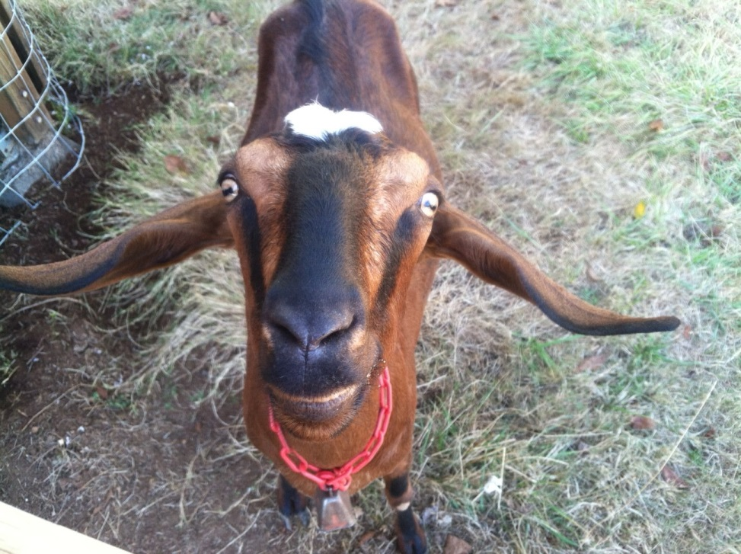
Disclaimers
The opinions expressed in this presentation are mine and may not reflect those of the North West Oregon Dairy Goat Association or American Dairy Goat Association.
I have four years of actively researching milk testing, but there are parts I don’t understand well.
The goats I have tested are almost all ADGA registered.

Slide 3
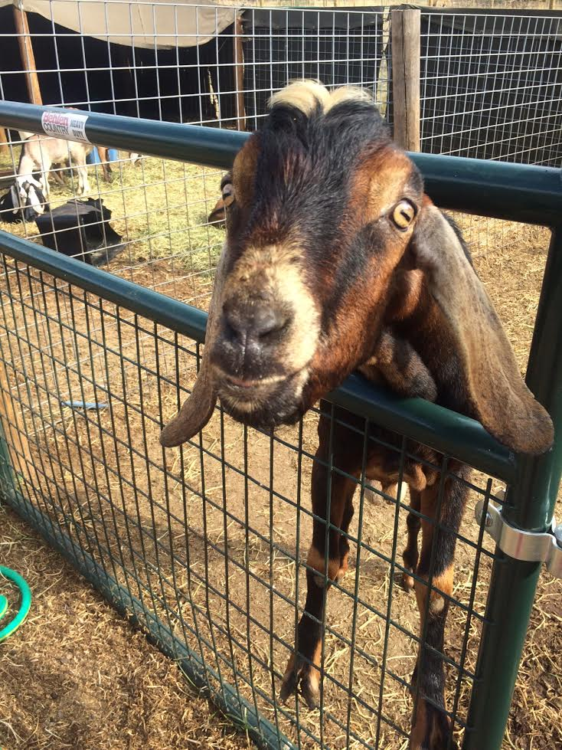
Who are you?
How many are on test now?
How big are your herds?
What breeds do you milk?
What registries are you with?
Are you looking for registry awards?
Do you have animals with registry awards?
Notes:
This is just to tailor the discussion to the correct audience

Slide 4
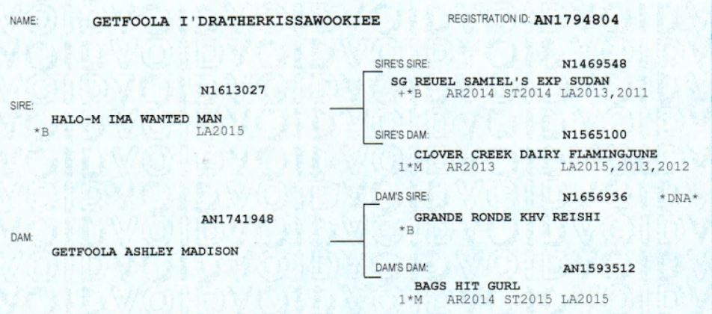
Why Milk Test?
Clear, visible record of production
Goat Cred
To earn awards/ increase value of herd
Data Nerdiness
Gain health information on herd
Ego
Level playing field to compare any goats
Decide who to keep and who to sell
You may want specific lactation curve shapes
Notes:
No “gallon a day” claims
Increased value is dependant on your customer- many buyers don’t understand or care about data
ADGA says there are “approximately 761 herds on milk test”. I’m a little no name American Nubian breeder from Estacada, but I will, and do, pit my girls against any goat in the nation. Some are better than us, but a lot aren’t.
Jesse was for sale, until I saw his daughters’ production.
Level playing field is a bit of a misnomer, since a lot of management goes into production, but you don’t need to be in an area with big name herds to do well

Slide 5
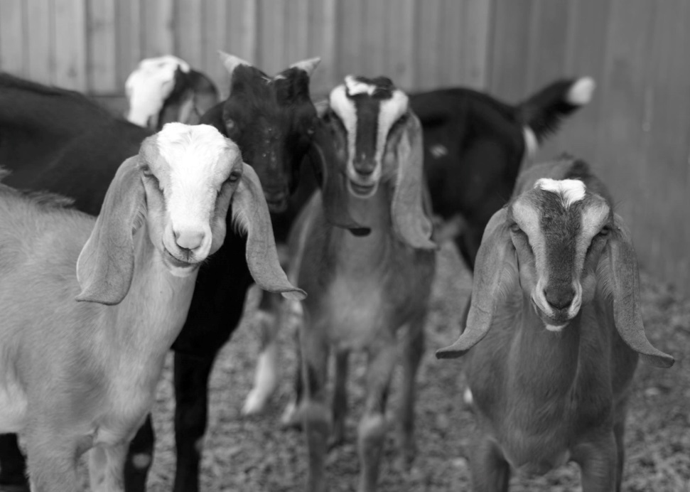
Why Does Milk Testing Seem Hard?
There are many variables such as test type, herd location, management styles.
Many herds that have been on test didn’t have a hard time starting and don’t realize some do.
Few people have hands on mentors.
Statistics involved are complicated.
A lot of acronyms are used.
Program is based on cows.
Some herds don’t want competition.
Photo by Louise Stivers, used with permission.
Notes:
Point out the Disclaimers slide again
There are some differences in cows and goats. We tend to keep retired animals, and kidding and litter sizes are very different. We have a much smaller data set than cows, so our statistics are much less valid.

Slide 6
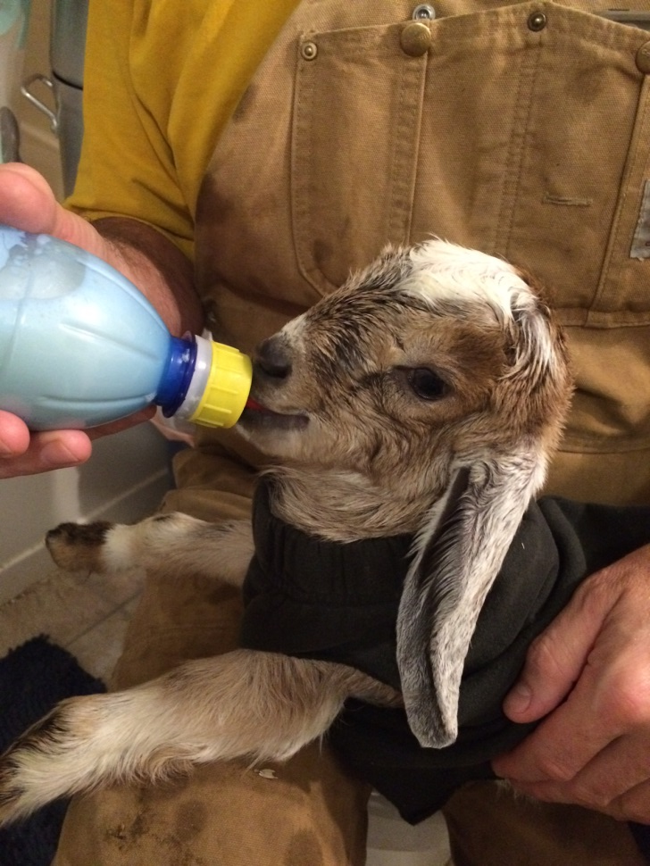
Is Milk Testing Hard?
On Test Day:
  Milk each goat separately, usually twice (12 hours apart)
    Weigh milk
    Sample milk
  Fill out form
  Mail milk to lab
  Get report from data center in 1-2 weeks
Notes:
You tell me. Crawling out of bed on a Sunday morning is hard…

Slide 7
You Don’t Have to Change your Herd Management
Dam raising
Once a Day milking
Breed only who you want
Dry off animals when you want
Don’t need registered animals
Machine or hand milk
Extended lactations
Notes:
You need to pull kids for 24 hours
Once a day milking will make your records look poorer than they really are
You are supposed to put all animals in milk on test
ADGA allows you to pick some breeds
305 days is a “full” lactation, the VAST majority of goats on test are dried off before that
Extended lactations will show the full number of days and raw test data, but will be cut off at 305 days

Slide 8
Starter Questions
Do you want to do most of the work yourself (owner sampler), trade working for other herds who work for you (group), or pay someone (possibly a neighbor in cookies) to do most of the work (standard)?
Do you care if you don't get genetic evaluations the first year you are on test? (Owner Sampler doesn't get an evaluation the first year on test)
Are you at risk of being on the Top Ten list? (Owner Sampler doesn't qualify for top ten, and you would need an extra verification test for other types)
Do you want to work with paper forms, or enter your test data on a PC?
Do you want to keep costs as low as possible, or can you pay a bit more for more convenience?
Do you care about being able to order disease or pregnancy testing from your lab, or if you can get MUN (which can tell you about your feeding program)?

Slide 9
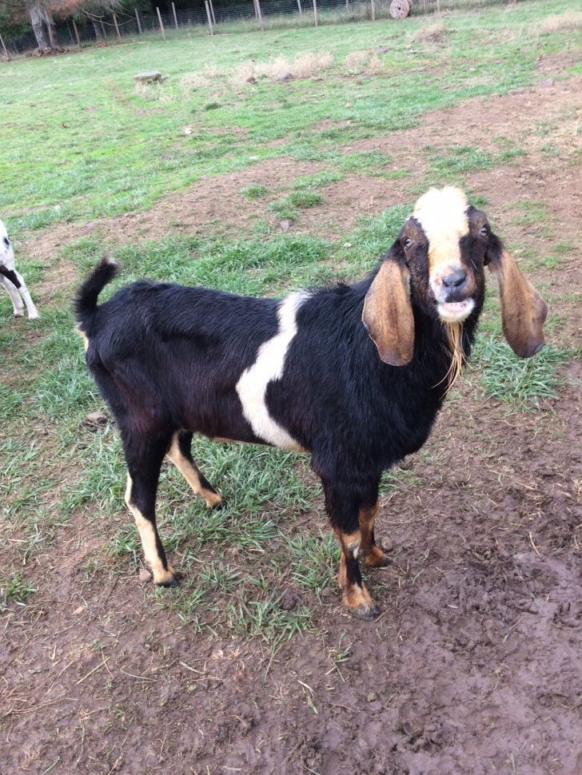
The Most Common Test Types
Owner Sampler
Standard
Group
Notes:
There are others I am less familiar with.

Slide 10
Owner Sampler
Owner does testing, once a year needs a Verification Test
    Owner must be a certified tester
Does do not get genetic evaluations the first year the HERD (not each animal) is on test
Does not qualify for ADGA Top Ten
Some do not put as much faith in the data
ADGA has two versions
    ST and AR
Notes:
The difference between ST and AR isn’t terribly clear
AR requires 240 days and 8 tests
ST does not have as much lactation data available
I don’t know why they don’t get an evaluation. A new Standard tester will qualify a herd for evaluations.

Slide 11
Standard Test
A certified tester handles all sampling and paperwork
Qualifies for Top Ten
Data Collection Rating (an evaluation of how “good” your data is) goes up quickly
Does not require a verification test unless you are at risk for top ten
Notes:
This is closest to the “normal” DHIA based on cows

Slide 12
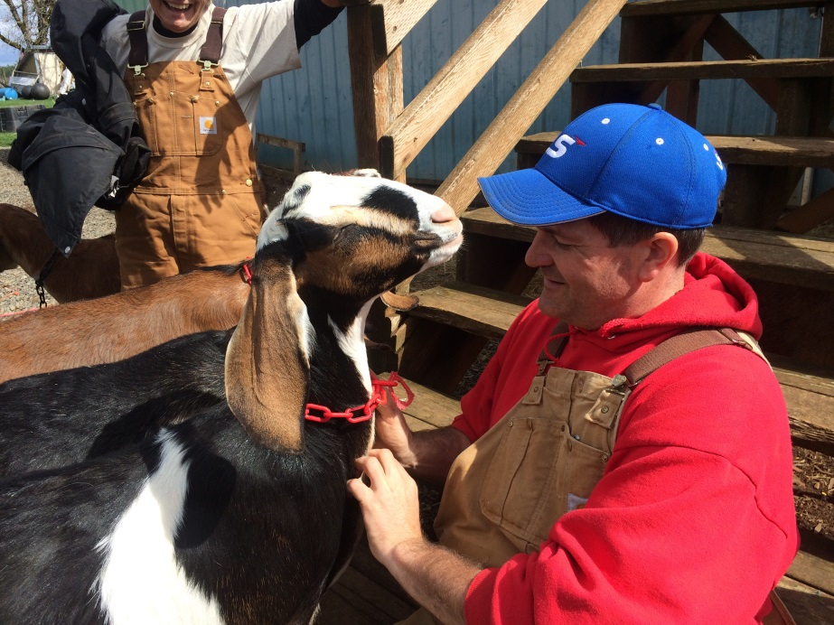
Group Test
A version of Standard
Three or more herds
Rotate testing other herds
  A tests B, B tests C, C tests A
  then
  A tests C, B tests A, C tests B
Traditionally involves adult beverages
Notes:
Herds cannot do “reciprocal testing” where they test each other the same month

Slide 13
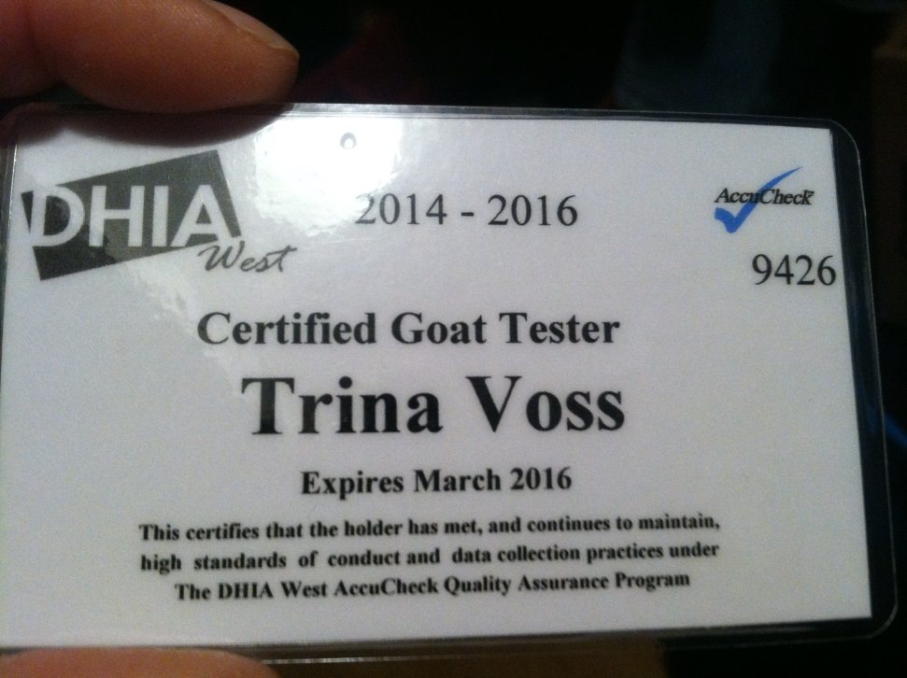
Tester Requirements
Certification- WA class today, online class with DHIA West, Langston https://www.youtube.com/watch?v=3FYgk9Izcuw
Cannot be a relative
Cannot co-own an animal with you
  Leasing animals is probably not acceptable
Can have bought goats from you or sold them to you
Some DHIAs have age requirements
DHIA sets requirements for testers
Notes:
Langston videos aren’t great quality
West is $40 and good for two years, training isn’t great
WA class may have low fee
If in doubt, check with your DHIA. Some have to assign a new tester number for testers they don’t certify

Slide 14
Equipment and How to Use It
Scale certified by DHIA https://www.amazon.com/American-Weigh-Scale-Digital-0-05-Pounds/dp/B0012TDR9E
Ladle from DHIA or restaurant supply store
Vials from DHIA
Bucket to weigh in
Pen for forms or computer for software
Scotch tape for vials
Visible ID tags
Notes:
$9-20 scale, hanging is preferred
Willamette DHIA is certifying for $12
Sticker on back shows certification date
Don’t ask for “calibration”
Some places like post office can certify
$2 salad dressing label from Cash and Carry restaurant supply store
If vials don’t have a lock, put scotch tape over the top
“Visible ID” must be readable from a few feet away- can be number or name

Slide 15
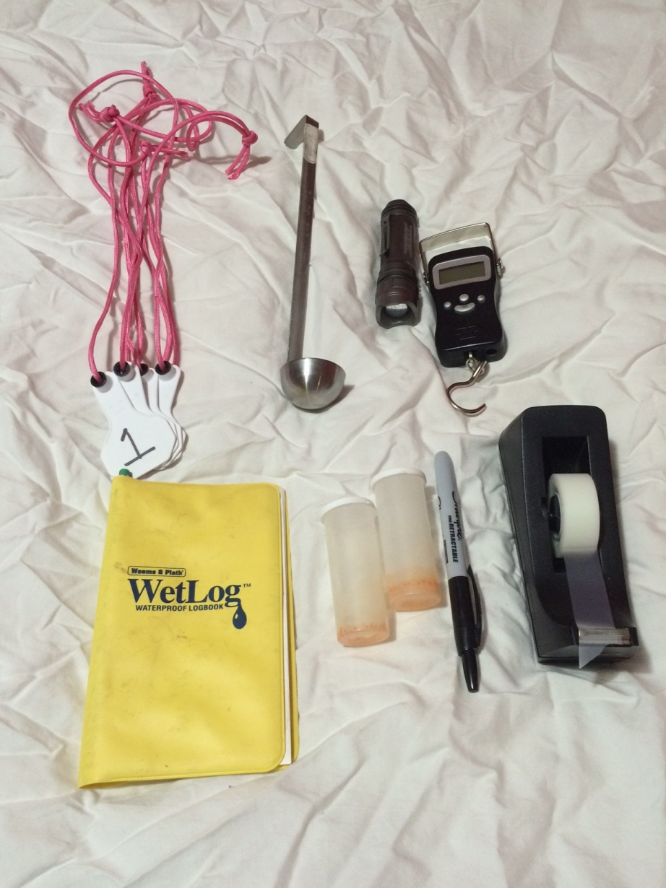
Test Day Equipment
Visible ID tags
Salad dressing ladle
Bright flashlight to check tattoos
Certified hanging scale
Waterproof Notebook and pencil
Vials with orange preservative
Sharpie marker for labeling vials
Scotch tape for sealing vials

Slide 16
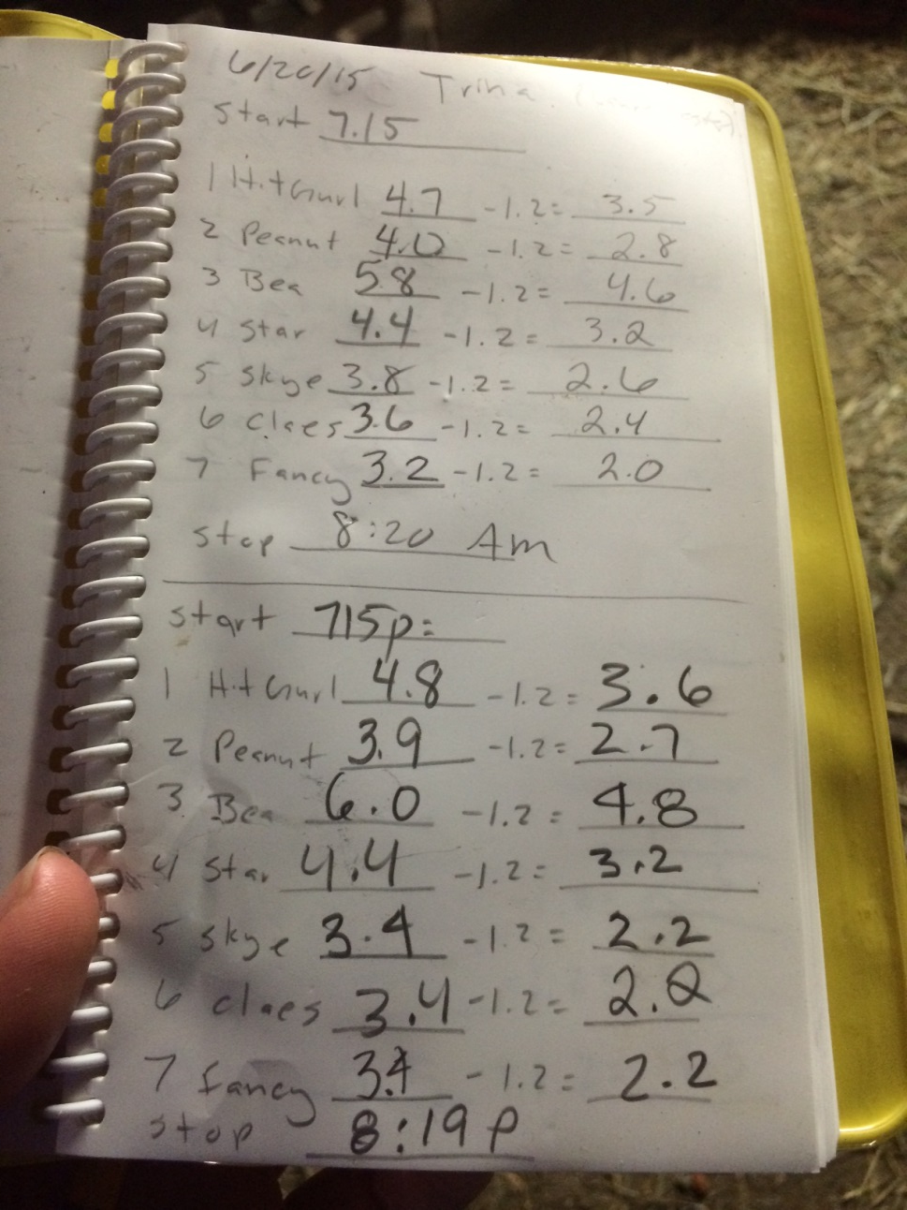
Write in the Rain notebook
Before the test, I set up the book.
I subtract the weight of my bucket (1.2 pounds)
I put the date, spaces for start and stop times, each animal’s index number, name, weight including the bucket, weight without the bucket.
We milk twice a day, so attempt to milk 12 hours apart, starting 12 hours after our last milkout.
Since this picture, I have added notes on weather, total weights for the day for each animal, total weight for all, and average weight per animal.
Notes:
You can use regular paper or write directly on forms.

Slide 17
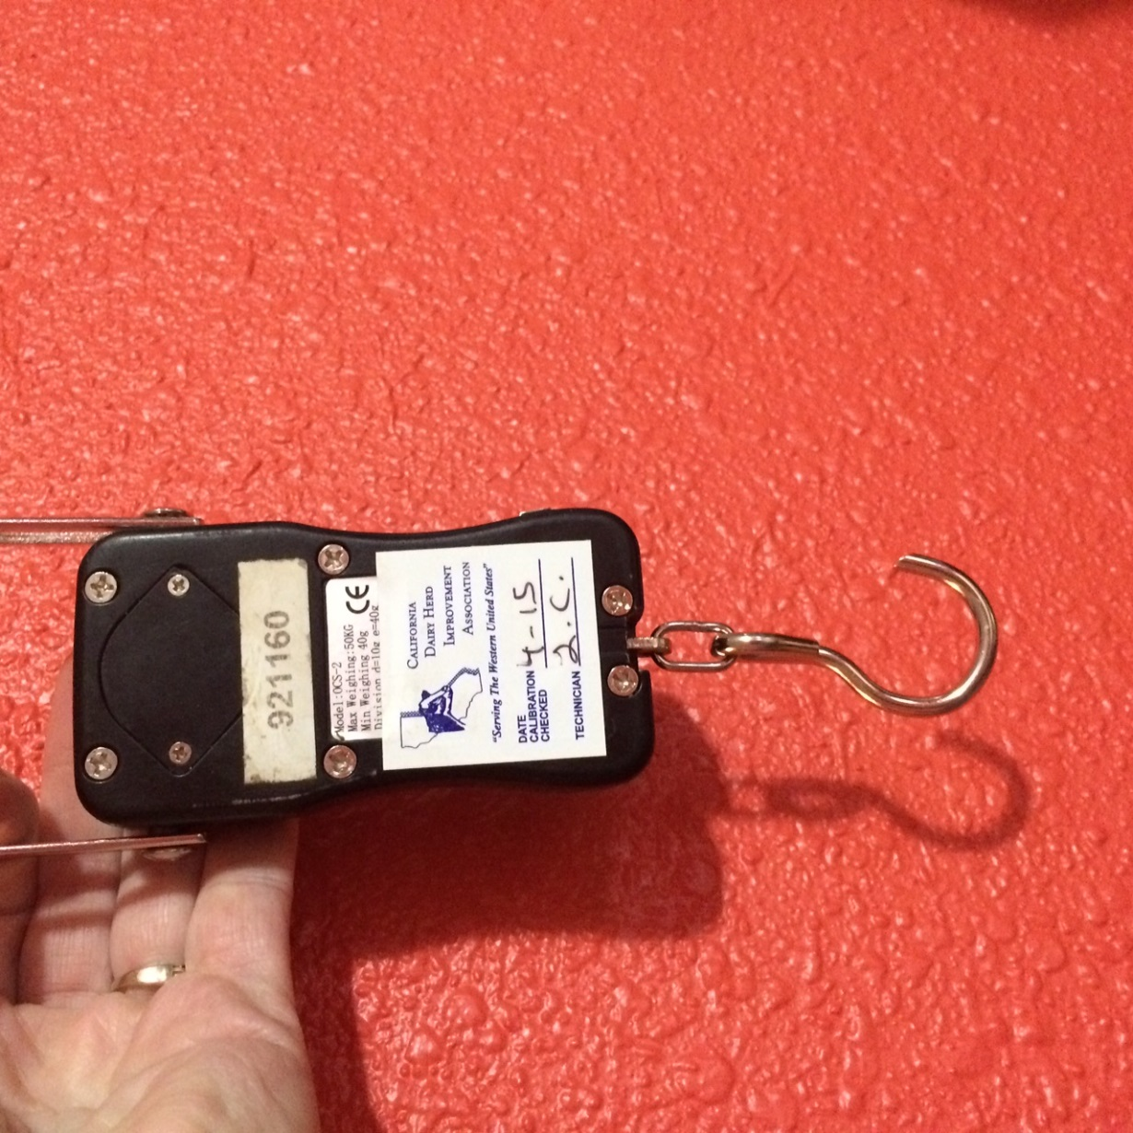
Scale that weighs in 1/10 pound and is certified by DHIA
DHIA West is doing scales here today.
You can ship scales to DHIA and have them mailed to you.
$12 charge.
The Verification Test form asks for the date of the scale certification.

Slide 18
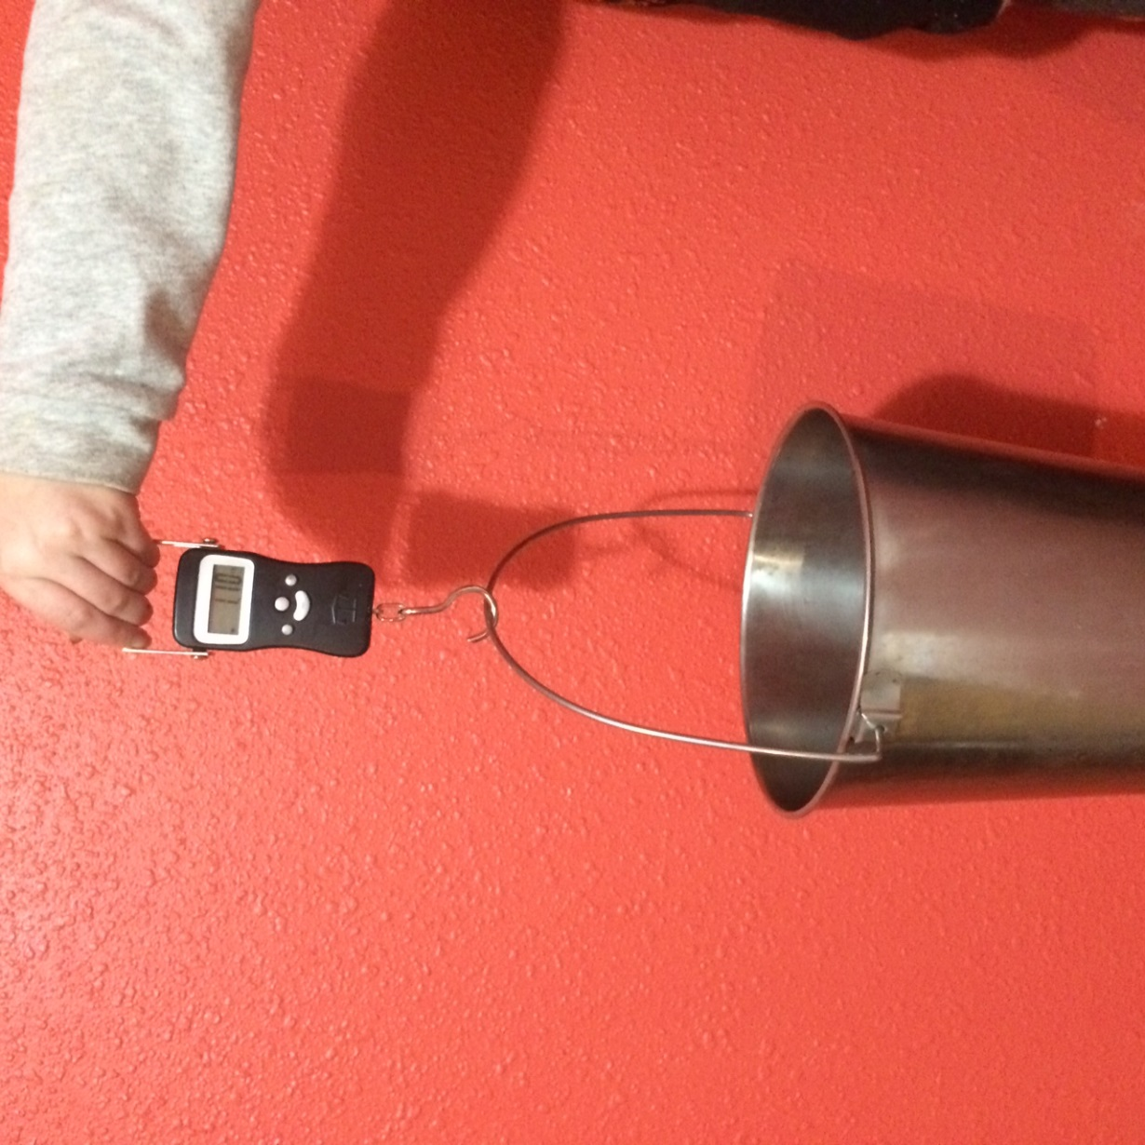
Weigh milk from each goat separately and record weight
Hanging scales are generally considered easiest
Some herds convert pounds and ounces, but most DHIAs/registries require scales that measure in 1/10 pound.
Weight is recorded in 1/10s.
I weigh two or three times to be sure.
You can milk into a bucket, or pour from a milking machine into a weighing bucket.

Slide 19
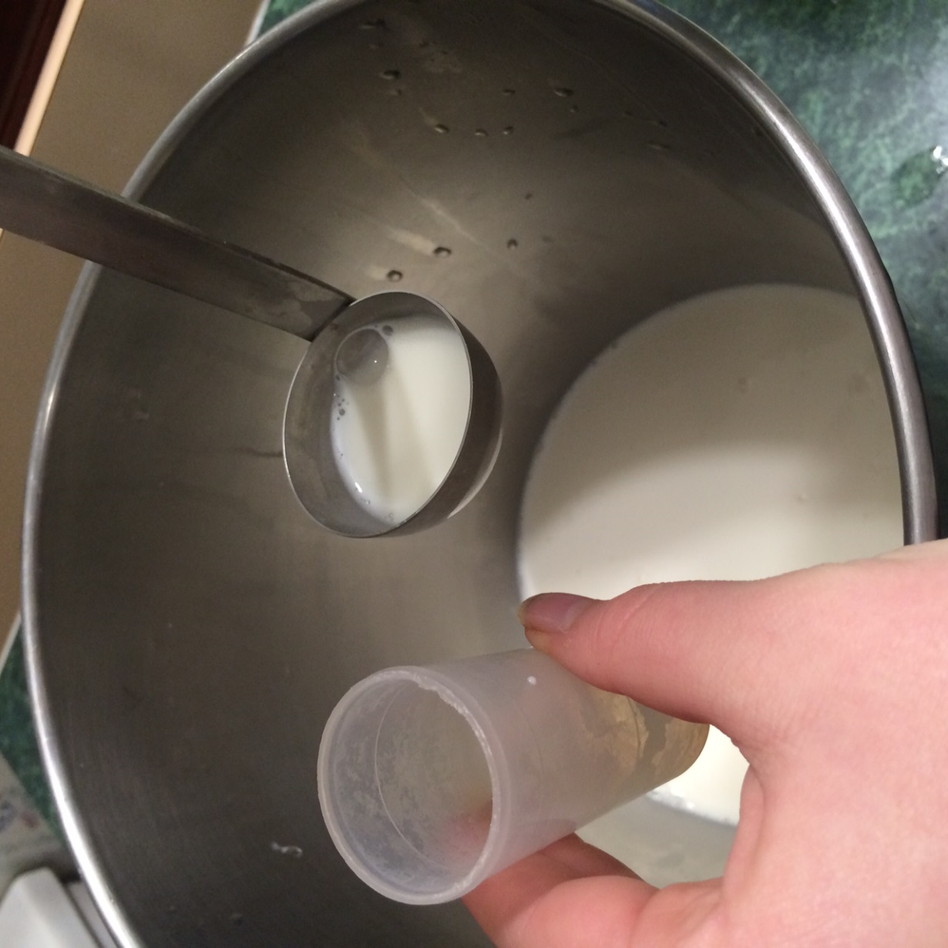
Mix milk thoroughly and fill the vial 40% from each milking
DHIA West recommends pouring milk between two buckets to mix.
Langston recommends stirring and scooping and dumping and stirring and scooping and sampling.
If you milk only once a day, fill the vial from the one milking.
Many vials have lines to fill to.
Leave some air space.
Be sure the vial has preservative, usually a spray or pellet.
Notes:
Goat milk separates quickly, so mix thoroughly, then sample quickly.

Slide 20
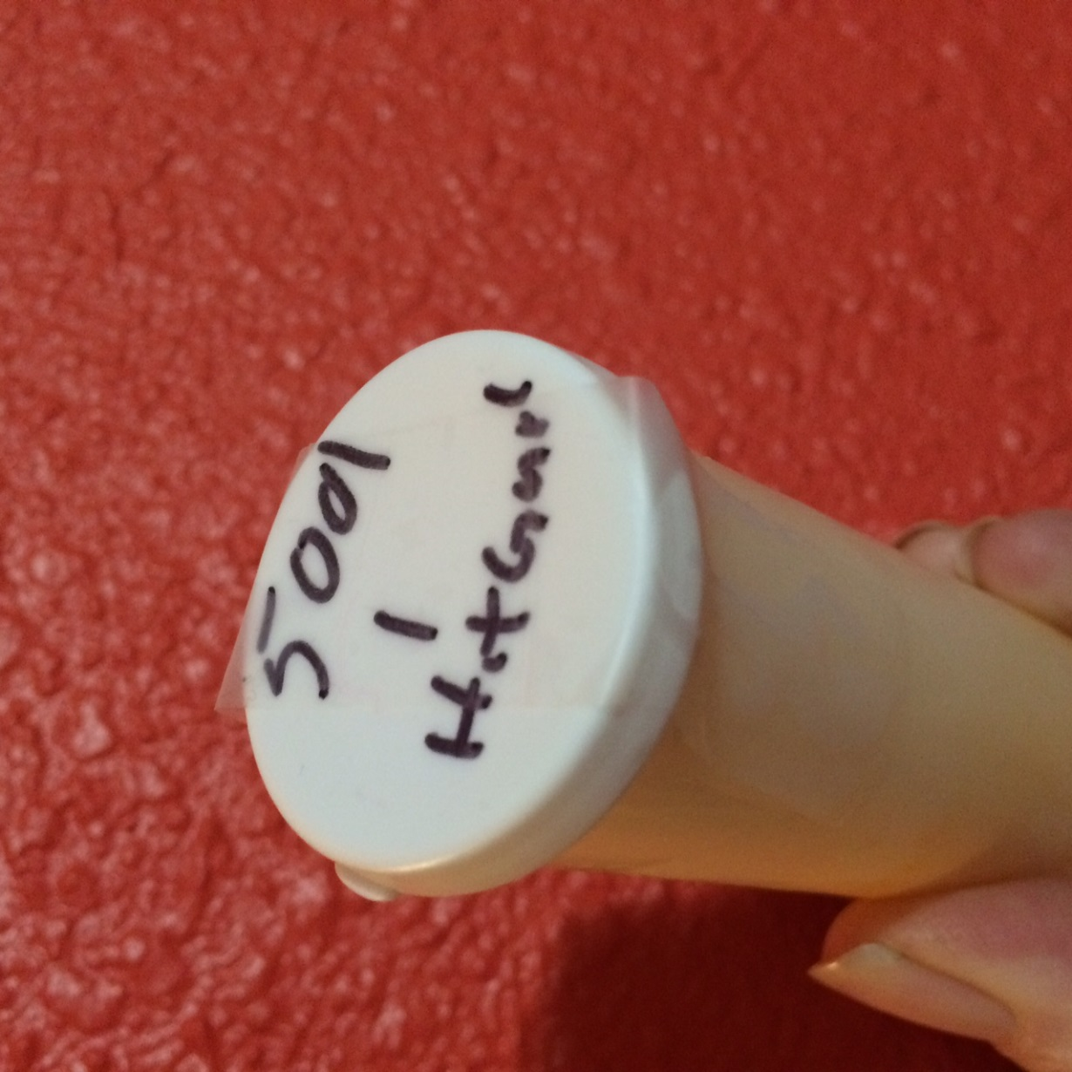
Labeled and Sealed Vial
I like to set up all vials before testing starts.
This is the last four digits of my herd number, the goat’s ID number, and her name, written in sharpie.
Be sure the vial audibly snaps shut. If it does not have a lock, a piece of scotch tape (not duct tape) will help keep it closed during shipping.
Put sealed vials in a plastic bag to contain leaks.

Slide 21
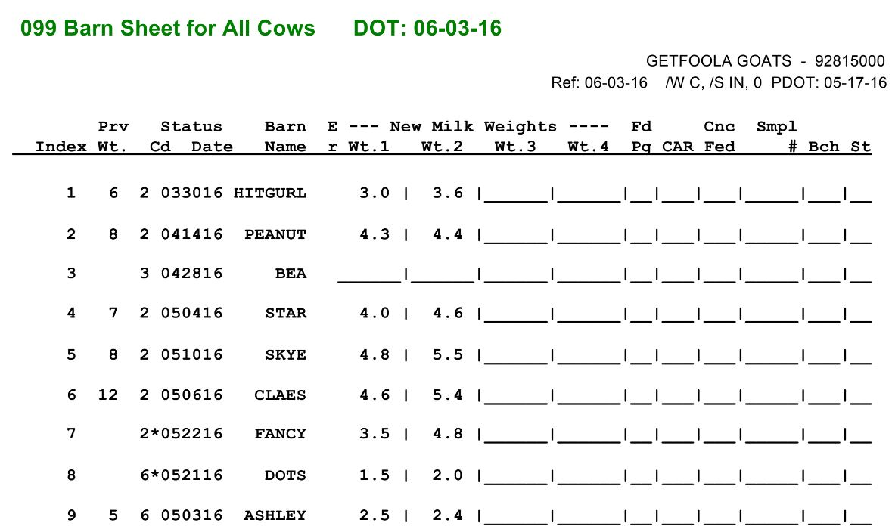
Printed Barn Sheet for Lab
Send with samples.
Shows animal number, last weight, codes and dates for kidding and drying off, the animal name, the weight of each milking, Conditions Affecting Record such as being in heat.
You can print blank barn sheets if you don’t want to use a notebook. I don’t like to take the official forms to the barn, since I spill milk on them.
Notes:
You may have other forms. Provo uses a triplicate from. DRMS uses software called PCDart (I used to print this) or paper forms.

Slide 22
Groups Involved in Getting Your Results
Dairy Herd Improvement Association
  DHIA
Data Records Processing Center
  DRPC
Council on Dairy Cattle Breeding
  CDCB
Registry
  ADGA, AGS, TMGR

Slide 23
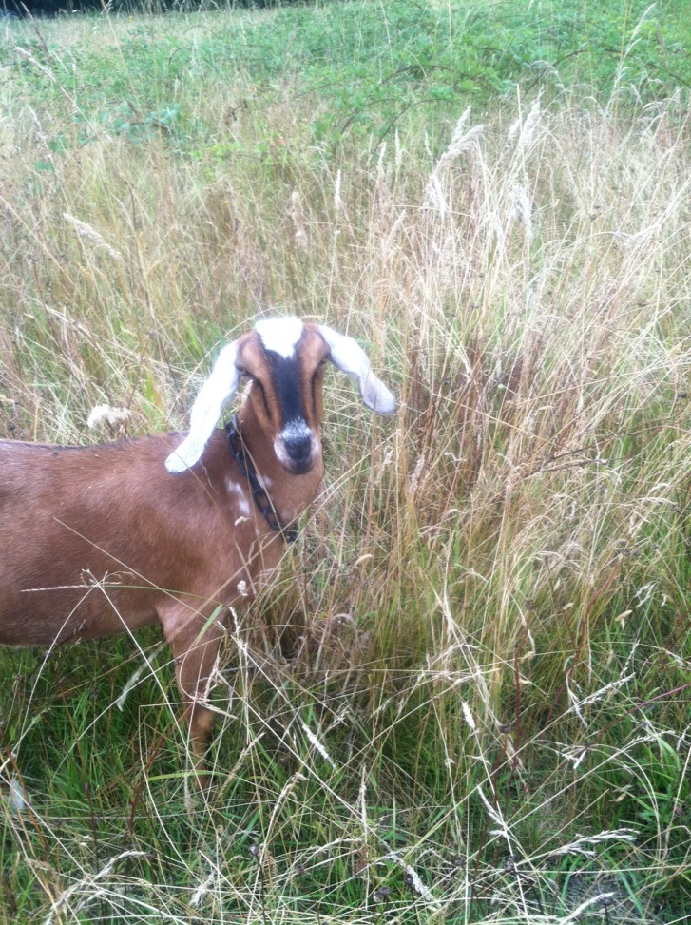
Role of Dairy Herd Improvement Association
Certify testers
Manage “nuts and bolts” of milk test
Receive samples and analyze components
Send component data to Data Center
Certify scales
Assign Herd Number
Notes:
DHIAs are Washington, Willamette, Langston and others

Slide 24
Role of Data Records Processing Center
Receive raw data on animals, weights, and components
Extrapolate data from sample to actual production to date
Extrapolate data from actual production to expected or Mature Equivalent production
Send data to owners, registries and Council on Dairy Cattle Breeding
Notes:
Provo and DRMS as well as others
CDCB website allows you to share raw data

Slide 25
Council on Dairy Cattle Breeding
“An industry collaboration that benefits the dairy community”
  Collaborate with USDA
  Maintains national records
  Maintains webpage which is easily accessible
    Webpage only works with ADGA or AGS registration numbers, American ID numbers, or 840 electronic ID numbers
    Requires a login
    Easily accessible from www.ADGAGenetics.org

Slide 26
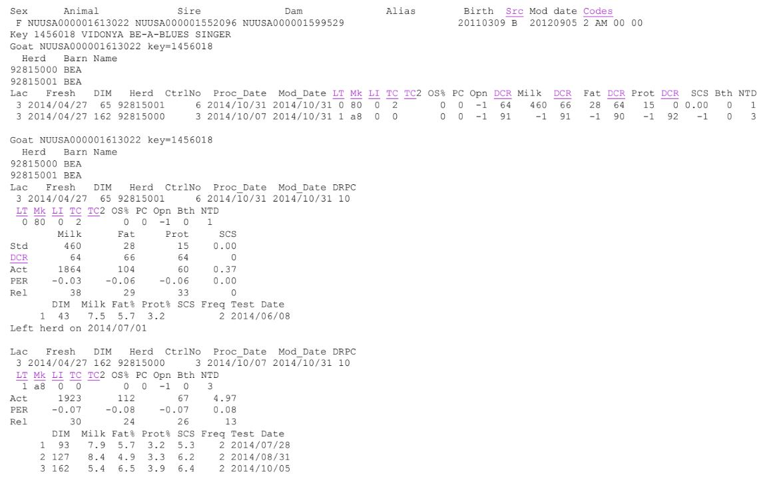
Bea’s page from the CDCB
This has information on the goat, the test type, and each test day. She was on her third lactation when she changed herds. The top section is over the total lactation per date, the lower part was for the third lactation. The last part is the actual test day information at each farm. You can go to the page directly, or through ADGAGenetics. This raw information is much more interesting to me than the evaluations and extrapolations.
Notes:
You can snoop on goats around the country. This has a ton of information including the data center I used, the number of tests per lactation, the number of times an animal on test changed herds, the lactation curve. You can learn a lot about the animals, but even more about the herd and if they share your priorites.

Slide 27
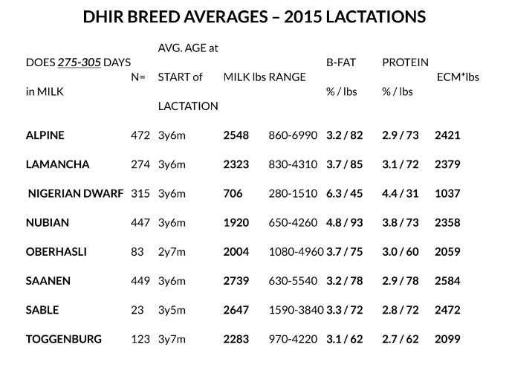
Role of Registries
Awards based on production
  ARTICLE II. PURPOSE Section 1. The purposes of this Association are: a. maintaining herd books and issuing certificates of registration and recordation of dairy goats; b. supervising and publishing official milk production records of dairy goats and issuing certificates of production; and c. promotion and regulation of matters pertaining to the history, publicity, breeding, exhibition, and improvement of dairy goats. (ADGA)
ADGA has the responsibility for genetic evaluations for all dairy goats
Working with a registry is optional
Notes:
Awards include stars, Superior Genetics (which requires linear appraisal as well) and Elite which is a USDA award, not a registry one

Slide 28
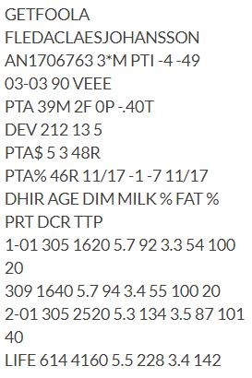
Milk Stars
*M for does who produce a minimum amount of total milk, fat or protein, or have three daughters who earn stars
  Can be “full DHIA” or “one day” tests
  Each doe earns a maximum of one ST and one AR star (generally)
  Stars “stack” by generation. 12*M is 12th in a direct line to qualify
*B for bucks with a dam who qualifies in total milk AND fat, or on a one day test, AND *B or +B sire (or sire’s dam who “double qualifies”)
+B for bucks with three daughters from three dams who earn stars OR two sons who have three daughters who qualify
  Can be *++B
Can only be seen on pedigrees printed after they are awarded, or by logging into ADGA.com and “looking up” animal

Slide 29
Milk Star Requirements
Similar but not identical for registries and breed clubs
  IDGR and INBA have levels and can be awarded multiple years
Depend on full size or Nigerian
Go up based on age at kidding
Not very difficult for most animals with full lactation
Full size requirements start at 1500 pounds milk, or 52.5 pounds fat, or 45 pounds protein (ADGA)
Nigerian Dwarf start at 600 pounds, or 21 pounds fat, or 18 pounds protein (ADGA)
A gallon of milk weighs 8.6 pounds
Test types may require a minimum number of tests or Data Collection Rating

Slide 30
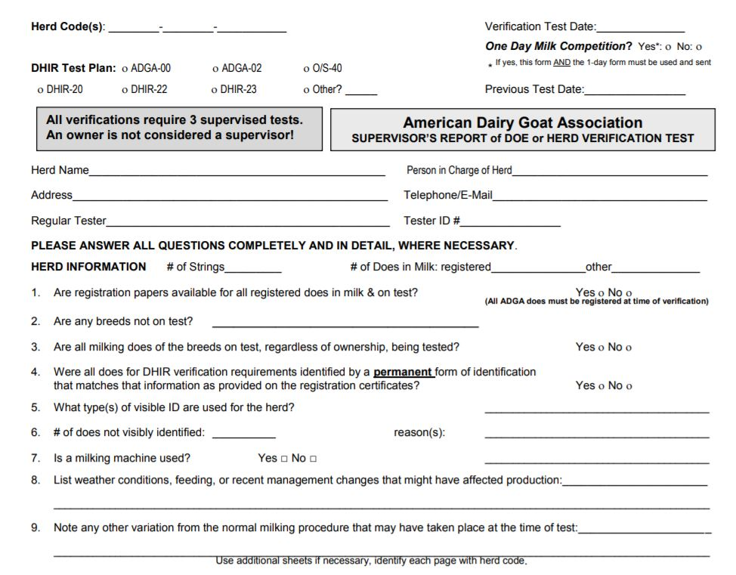
Verification Test
Requires three supervised milkings (milk out and two which are weighed and sampled)
Requires checking of pedigrees, tattoos, and “visible ID”
An additional form is sent with the milk which will be forwarded to the registry
May be required by some test types or for some awards
Can be requested by registry or just as additional evidence your data is valid

Slide 31
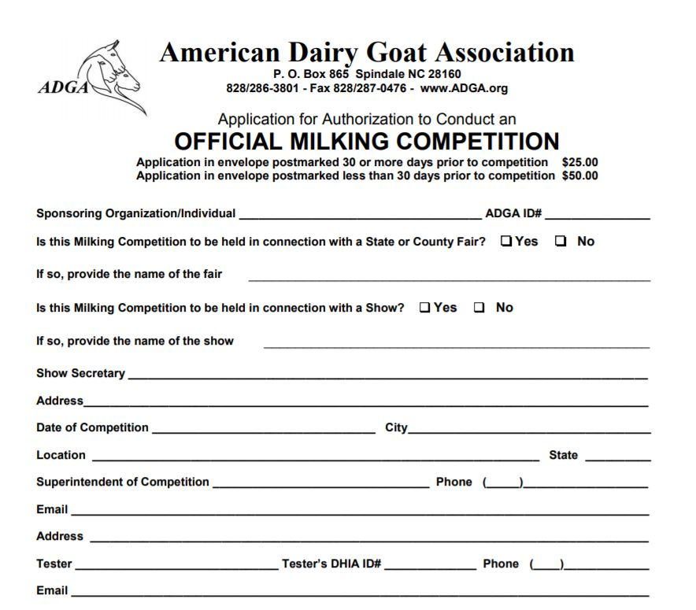
One Day Test (ADGA)
Similar to a Verification Test
Can be used for a Verification Test
Has additional paperwork
Is a “snapshot” of production
Is pretty hard to earn
Based on a point system considering time in milk, total milk, and fat percentage
Data is only found if you buy the Performance Volume for that breed and that year
Can be done at your farm
Notes:
I used to be snobby about one day stars until I ran my records through a calculator. Only my two best does, on their best day qualified, even though all earned “full DHIA” stars

Slide 32
Tips and Tricks
You don’t need to use the closest DHIA.
Prices and service can vary, so shop around.
Vials ship almost anywhere in the US in a few days using USPS Priority Mail boxes.
Mark vials with your herd number, animal name, and ID number.
If your vials don’t lock, put a piece of tape over the top.
Samples should be usable for up to ten days and don’t need refrigeration unless it is very hot.
A bar of goat milk soap in your sample box makes the DHIA happier to stop a 1,000 vial cow dairy run for 9 goat vials.

Slide 33
Tips and Tricks Continued
If you feel frustrated or stupid in the setup process, it is not you.
The more organized you are before you start, the more smoothly the test will go.
Keep a spare certified scale in case you drop one in a milk bucket.
The owner milks the goats, the tester supervises and handles all weighing and sampling.
For a genetic evaluation, the doe must be on test for over 40 days.
For a buck to receive a genetic evaluation, he must have 5 daughters with evaluations.
To be included in ADGA’s breed average, a doe must be on test for over 275 days.

Slide 34
Still More Tips and Tricks
Check your data on the CDCB site for errors.
If you use Provo, they extrapolate production out two weeks. Never dry off a goat that has just enough production for an award until you are sure she has really qualified.
If a buck is expected to have a *B and doesn’t, the problem is usually the dam did not produce enough total milk.
The CDCB breed average includes all animals in a herd with a majority of that breed, regardless of how long they are on test.
The ADGA breed averages is from approximately 2,200 animals, the CDCB breed averages are from approximately 17,000 animals.
For a genetic evaluation, the doe needs to go on test within 90 days of kidding.
A doe can earn stars in the first 305 days of test, regardless of when she starts.

Slide 35
Yet More Tips and Tricks
More tests mean more and better data, but also more costs.
Does are expected to peak around day 45, so starting test before then improves your numbers.
Does dried off more than 45 days after their last test will have the data examined to see if it can be used (ADGA).
You can change test type, DHIA, or DRPC.
The best option may be to have a friend get certified and be your tester the first year, then switch to owner sampler.
By definition, not all goats can be above average. If your production isn’t where you want it to be, you can change genetics and management to get there.

Slide 36
Instructions
Red Horse Valley
Milk Testing – It doesn’t need to be as intimidating as initially it appears to be! http://static1.1.sqspcdn.com/static/f/378878/26595047/1444408227837/Starting+on+Milk+Test+July+2015+update.pdf?token=BPyJeOlkRsy4hwdowVp72Le6znQ%3D
Narrow Gate Nigerian Dwarf
Understanding DHIA
http://narrowgatenigeriandwarf.com/blog.html
Land of Havilah Herbals
Info on DHIA (Milk Test)
http://landofhavilahfarm.com/loh/natural-raising/other-helpful-information/info-on-dhir-milk-test/
https://www.facebook.com/groups/DHIAgoats/
Notes:
https://www.uscdcb.com/

Slide 37
Partners
The Council on Dairy Cattle Breeding
https://www.uscdcb.com/
National Dairy Herd Improvement Association
http://www.dhia.org/
Dairy Records Management Systems
https://www.drms.org/
DHIA-Provo
http://www.dhiprovo.com/

Slide 38
Local DHIAs
Washington State Dairy Herd Improvement Association
http://www.wa-dhia.com/
Willamette DHIA
office@wdhia.org
DHIA West
http://www.dhiawest.com/

Slide 39
Registries
American Dairy Goat Association
http://adga.org/performance-programs/production-testing/
American Goat Society http://www.americangoatsociety.com/milkpail/milk_production_awards.php#
The Miniature Goat Registry
http://www.tmgronline.com/milk-test-how-to
International Dairy Goat Registry
http://www.idgr-ifbr.com/dairy-goat-milk-test.html

